Slide 1
Enhancing Performance Of Operating System Using Machine Learning
Project Members:
1. Lakshay Bansal (287/CO/12)
2. Ravish Mahur (339/CO/12)
3. Rishab Banerjee (340/CO/12)

Slide 2
ABSTRACT
There is no single scheduling or memory management algorithm that could provide good performance consistently under varying environment –Being affected by workload(type and size of Program/data), file system, disk system.
Therefore, a new self learning approach is proposed which can adapt to various types of workloads, and make decisions for optimizing the performance of the OS.

Slide 3
Work Hitherto
Courses Pursued
Machine Learning (Dr. Andrew Ng, Stanford University)
Introduction To Data Science (Dr. Bill Howe, Washington University)
Artificial Intelligence(UC Berkeley)
R Programming (Dr. Roger Peng, John Hopkins )
Research Papers Read
Self Learning Disk Scheduling (IEEE)
Applying Machine Learning Techniques to improve Linux Process Scheduling (IEEE)
To Collect Or Not to Collect? Machine Learning For Memory Management (Eva, Olof (Folkangagaton 122))
Dynamic Resource Management: A Machine Learning Approach

Slide 4
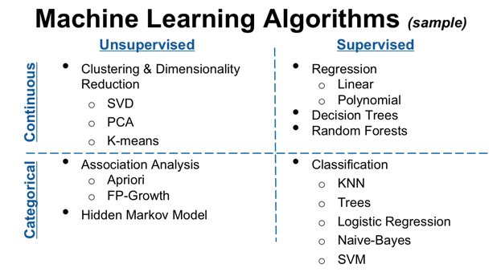
Machine Learning Algorithms

Slide 5
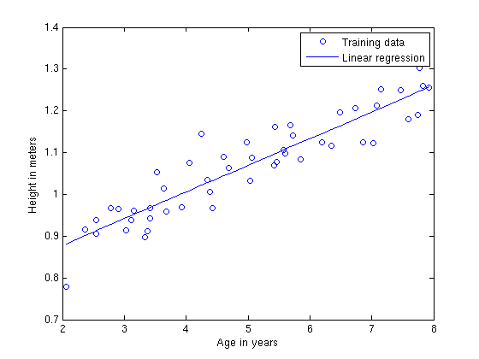
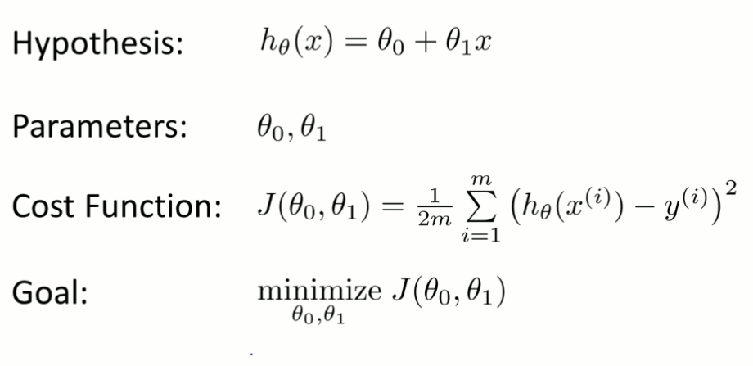
Linear Regression
Regression is used to predict scalar (continuous) values given some inputs.
A cost function ,called "Squared error function" is used to find the accuracy of the hypothesis function.
Gradient Descent or Normal Equation can be used to find the values of parameters (theta 1 and theta 2) that minimize the cost function.

Slide 6
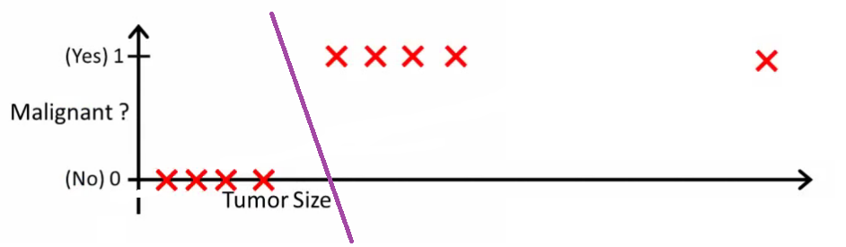
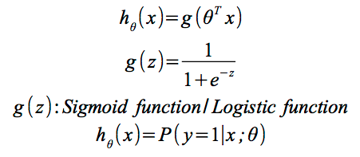
Logistic Regression
Is a statistical classification model
Predicts binary response from a binary predictor for predicting the outcome of a categorical dependent variable
Applications :
  Predict whether a voter will vote for Congress or BJP based on age, income, gender, caste etc
  Predict whether a tumour is malignant or benign
  Whether a job is IO bound or CPU bound

Slide 7
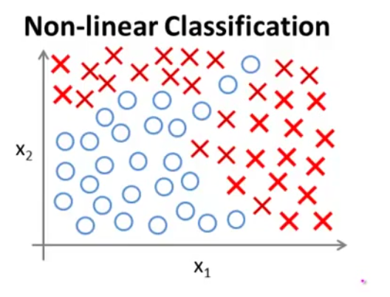
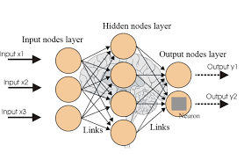
Neural Networks
In order to model any complex non linear
hypothesis as shown, higher order polynomials
may be required. As the degree of the
polynomial increases it becomes computationally
expensive to calculate the values.
Neural networks come handy in such situations.
Instead of calculating the features at one go, the work is divided into steps. The neurons mimic the human neurons.
Every node acts as a neuron, it takes input
from one or more nodes and does some
processing and passes the processed data
to the connected nodes in the next level.
The nodes are partitioned into layers with
output of nodes at layer i-1 feeding nodes
at i.
The user only has to interact with the input
and output layer. The intermediate layers
stay hidden from the user.
The parameters are called weights.
Biasing inputs may be applied to a neuron.

Slide 8
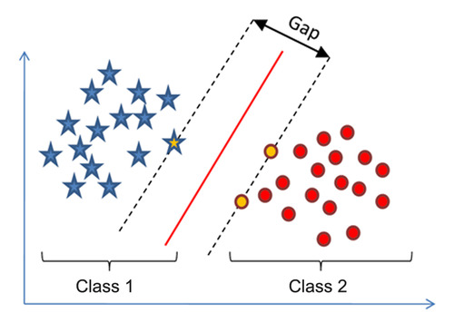
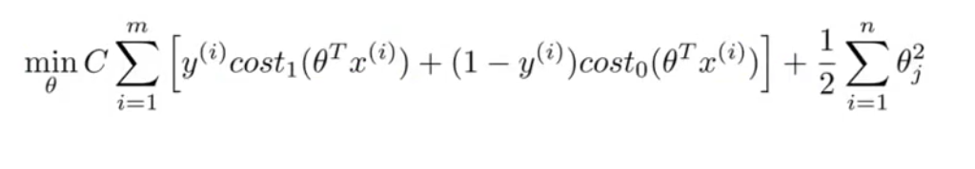
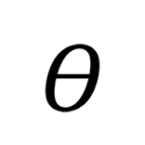
CLUSTERING-
SUPPORT VECTOR MACHINE
The main objective of SVM is to create a
decision boundary such that the different
classes have the maximum possible distance
from the decision boundary.
In the figure shown the red circles and the
blue stars which lie close to the decision
boundary should be equally spaced from the
decision boundary, and as far as possible
from it. This ensures a clean separation of the
different classes.
Minimize the above error function and get
If t*x >= 0 predict output 1
Else predict output 0
The value of C determines after how many cross overs should the decision
boundary be finally shifted. Due to this reason SVM is also called large margin
classifier

Slide 9
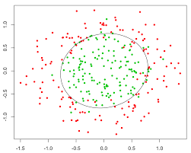
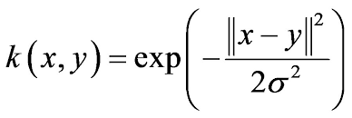
CLUSTERING: KERNEL
If the concept of SVM is applied to complex systems which have non trivial decision boundaries such as the one shown in figure, over fitting might occur or we may have to use polynomial regression of high orders, that is there is a chance of over variance or the calculation blowing up. In order to resolve this Kernel Functions are used.
Landmark points are chosen one for
each training data and euclidean distances of all other data points are
measured. Depending upon this
distance the respective training set is
assigned a class value.
Types of Kernel Functions:
Gaussian Kernel
Polynomial Kernel
Chi-Square Kernel
Histogram Intersection Kernel
Gaussian Kernel =>

Slide 10
CLUSTERING-
K-MEANS
UNSUPERVISED LEARNING
Here we are not provided with any label. The data should automatically classified
that is similar data should go in same groups.
The K-Means is the most widely used algorithm for unsupervised clustering. The
Input data is automatically split into K or less groups (here K is provided by the
user)
Algorithm:
Randomly initialize k cluster centroids u1, u2, u3,..., uk
Repeat{
for i in 1 to n
ci = index (from 1 to k) of cluster centroid closest to uj
    for i in 1 to k
    ui = mean of the points assigned to cluster u
}
In the first for loop the points are assigned one of the clusters and in the
second for loop the cluster centroids are reassigned

Slide 11
FOCUS AREAS
Optimize the performance of the following aspects of OS:
Process Scheduling
Memory Management
Disk Scheduling
Cache Replacement
etc...

Slide 12
PROCESS SCHEDULING
Intuition
Generally process schedulers allocate CPU time slices to a process according to a scheduling algorithm that does not use any previous execution history of the process. It might be possible to better utilize resources if we could “recognize” a program and predict its resource requirements.
Approach followed (in the research paper read):
Predictive scheduling based on decision trees using static and dynamic attributes (size of program, data size, type of input etc) reduced the TaT by about 6%. This was due to a reduction in the number of context switches needed to complete the process execution.
Modifications/ Improvements Possible:
Application of other techniques like neural networks and comparison of the overheads and performance and find the best possible alternative and achieve accuracy close to SJN scheduling.

Slide 13
MEMORY MANAGEMENT
Garbage Collection is a very important part of the modern day systems. As the pointer and variable sizes increases, there is also a corresponding increase in the processes and thus there is immense load on the OS to free up as much memory as possible.
Most garbage collectors like parallel garbage collection and stop-and-copy start the garbage collection process only after the heap becomes full. A full heap would cause all application threads to stop, which would not be necessary if some kind of concurrent garbage collection had started in time.
We plan to let a learning decision process decide which garbage collector technique to use and how to use it, instead of static rules making these decisions during run time.
The problem can be modeled as a Markov Decision Processes (MDP) and Reinforcement Learning Methods have generally been used to solve these problems.
We plan to combine the existing garbage collection mechanisms and Reinforcement Learning Methods enhance the process of garbage collection, by determining when to apply which garbage collection algorithm.

Slide 14

DISK SCHEDULING
Self-learning disk scheduling schemes:
Change-Sensing Round-Robin Selection
Feedback Learning
Per-Request Disk I/O Scheduler
Two-Layer Combined Learning Scheduler (Best Performance) - It employs feedback learning techniques to analyze workloads, change scheduling policy, and tune scheduling parameters automatically.
We discuss schemes to choose features for workload learning, divide and recognize workloads, generate training data, and integrate machine learning algorithms into these schemes.
How we will achieve optimizing of the Disk Scheduler?
By comparing the accuracy ,performance and overhead of the ML algorithms in implementing these schemes :- Decision Tree, Naive Bayes, Neural Network ,logistic regression, and Support vector machine, we will try and further optimize the performance of the above mentioned algorithms.

Slide 15
Adaptive Replacement Cache
Algorithm
The self-tuning, low-overhead, scan-resistant adaptive replacement cache algorithm outperforms the least-recently-used algorithm by dynamically responding to changing access patterns and continually balancing between workload recency and frequency features
ARC maintains two LRU pages lists: L1 and L2.L1 maintains pages that have been seen only once, recently, while L2 maintains pages that have been seen at least twice, recently. Hence, we say that L1 captures recency, while L2 captures frequency.
ARC adapts quickly and effectively to a variable workload size. A real-life implementation revealed that ARC has a low space overhead—0.75 percent of the cache size. Also, unlike LRU, ARC is scanresistant in that it allows one-time sequential requests to pass through without polluting the cache or flushing pages that have temporal locality.
Likewise, ARC also effectively handles long periods of low temporal locality

